Slide 1
Microsoft 365 Device Series Welcome Deck
December 2018
M1
Microsoft 365 Device Series

Slide 2
Good Morning ☺ Welcome to the FY19 Microsoft 365 Device Series Training
Lab Details (if you want to prep)
https://m365.learnondemand.net/
Lab key ________________________
WiFi Info
SSID: ______________________
Password: _________________
Microsoft 365 Device Series
Notes:
Instructor should show this slide while attendees are entering and getting comfortable. Please update WIFI and Lab details as appropriate for each class.

Slide 3
Few things about me:
Instructor’s Name
Microsoft 365 Device Series

Slide 4
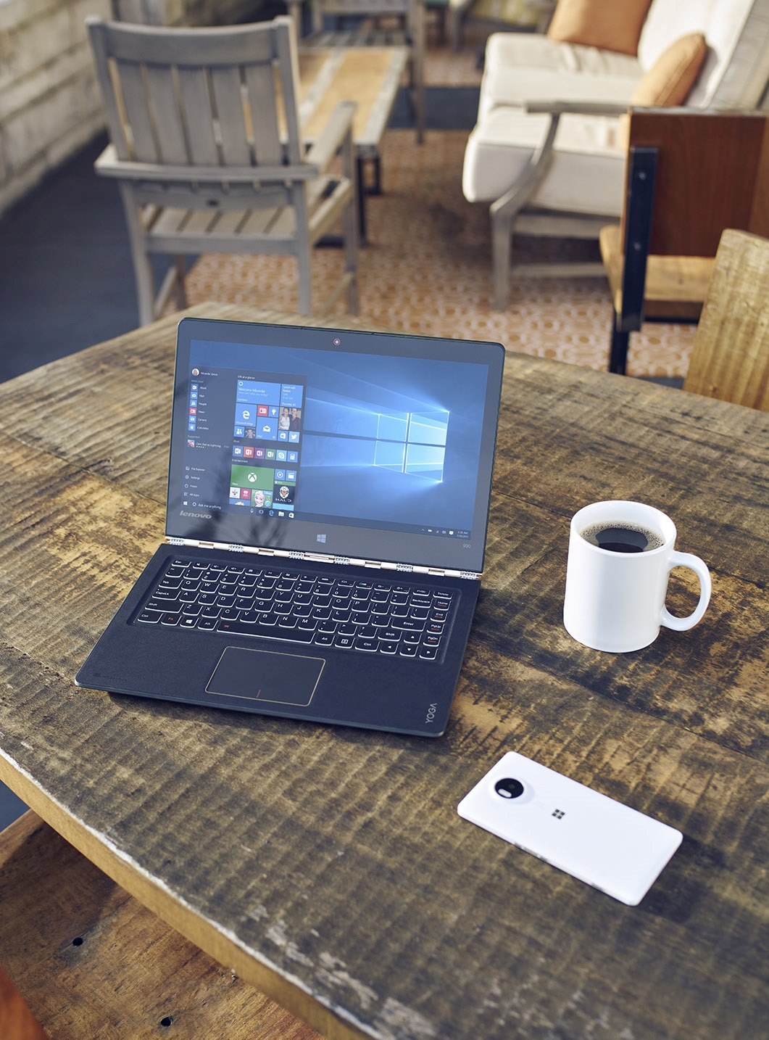
Agenda
Introductions
Logistics
Agenda
Surveys
Microsoft 365 Device Series
Notes:
Title: Objectives
Length: 2 minutes
<Instructional Designer: List the module learning objectives here. You can use longer descriptions than slide bullets if you want to.>
Start Time xx:xx / Length: 2 minutes
Review the learning objectives.

Slide 5
Logistics
Restrooms
Breakrooms/Coffee
Building Hours
Breaks and Lunches
Classroom organization / Wi-Fi / etc.
Microsoft 365 Device Series

Slide 6
Microsoft 365 Device Agenda
Microsoft 365 Device Series

